Slide 1
INGENICO JOURNEY

Slide 2



What is a “Payment Service Provider” ?
Notes:
Individual components scalable
Easy to introduce and replace new technology
Easy to deploy new features
Autonomous teams can continue to improve

Slide 3


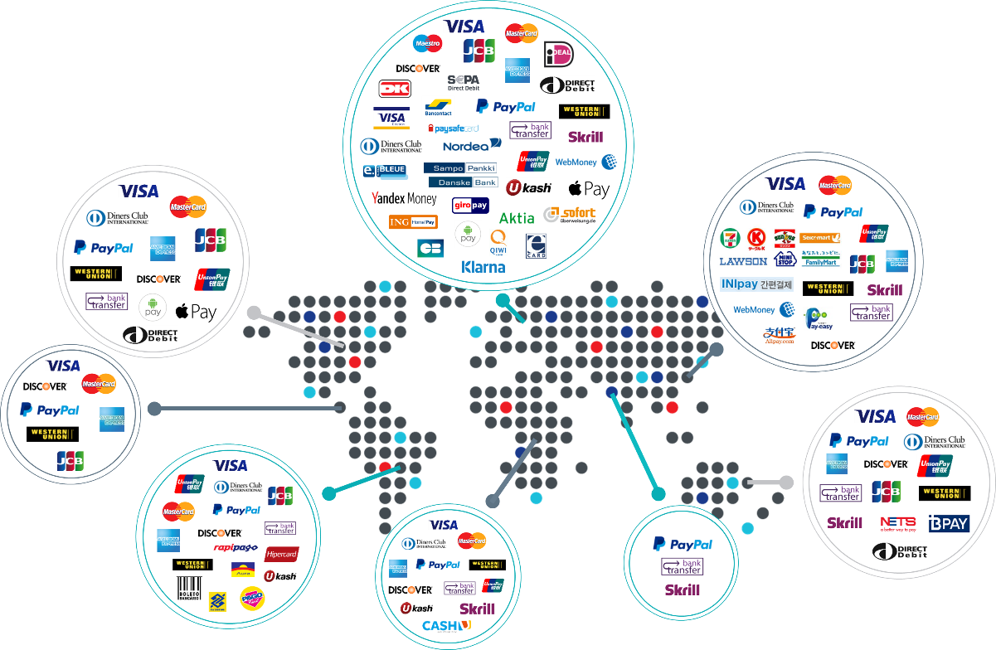




65.000 Customers
800+ Employees
170 Countries
150+ Payment Methods
$
150+ Valuta
WE ARE #FINTECH
Notes:
Wie weet het?
Er zijn meerdere definities:
Alles met Fin en Tech
Disruptive zoals Knab, BitCoin, Online spaarrekening -> new technologies to be cheaper en quicker

Slide 4
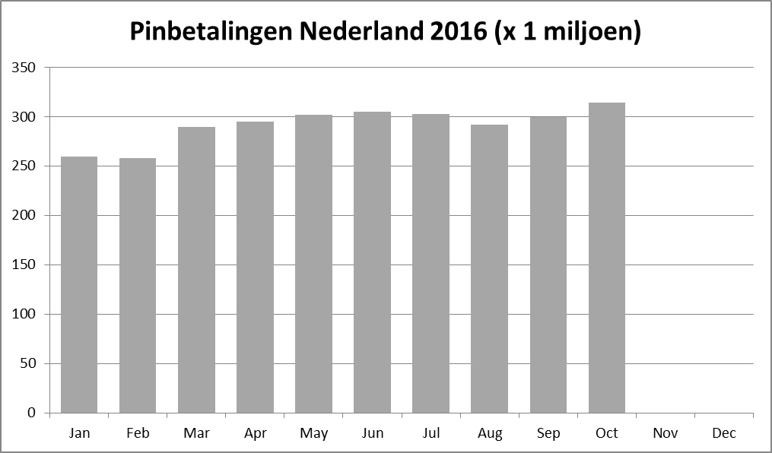
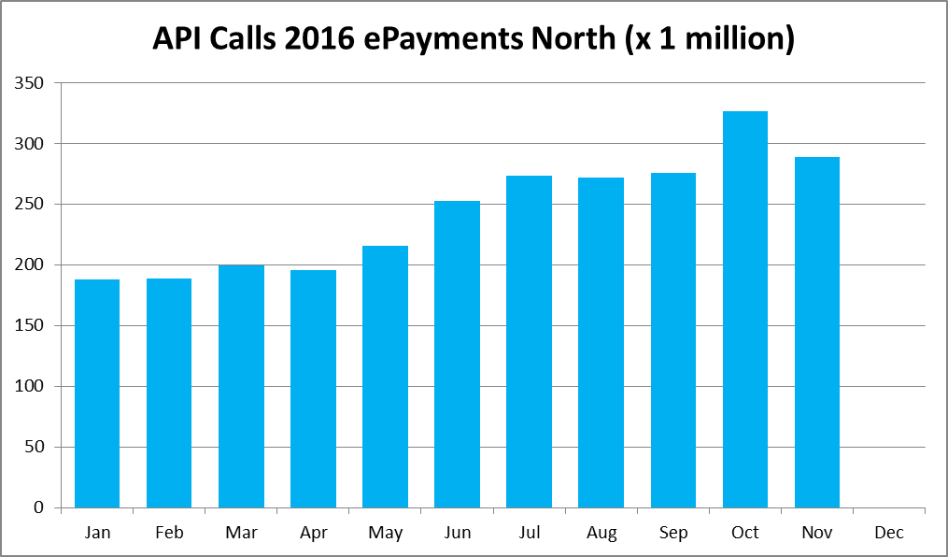
‘PIN’ (NL) VS e-PAYMENTS
Source: betaalvereniging NederLAND
November 2017

Slide 5





The Ingenico journey
START-UP
Result
PAST
NOW
FUTURE
1994
2014
2017

Slide 6



InSPIRED BY THE BEST
ORGANIZATION
ARCHITECTURE
CI / CD
>_

Slide 7
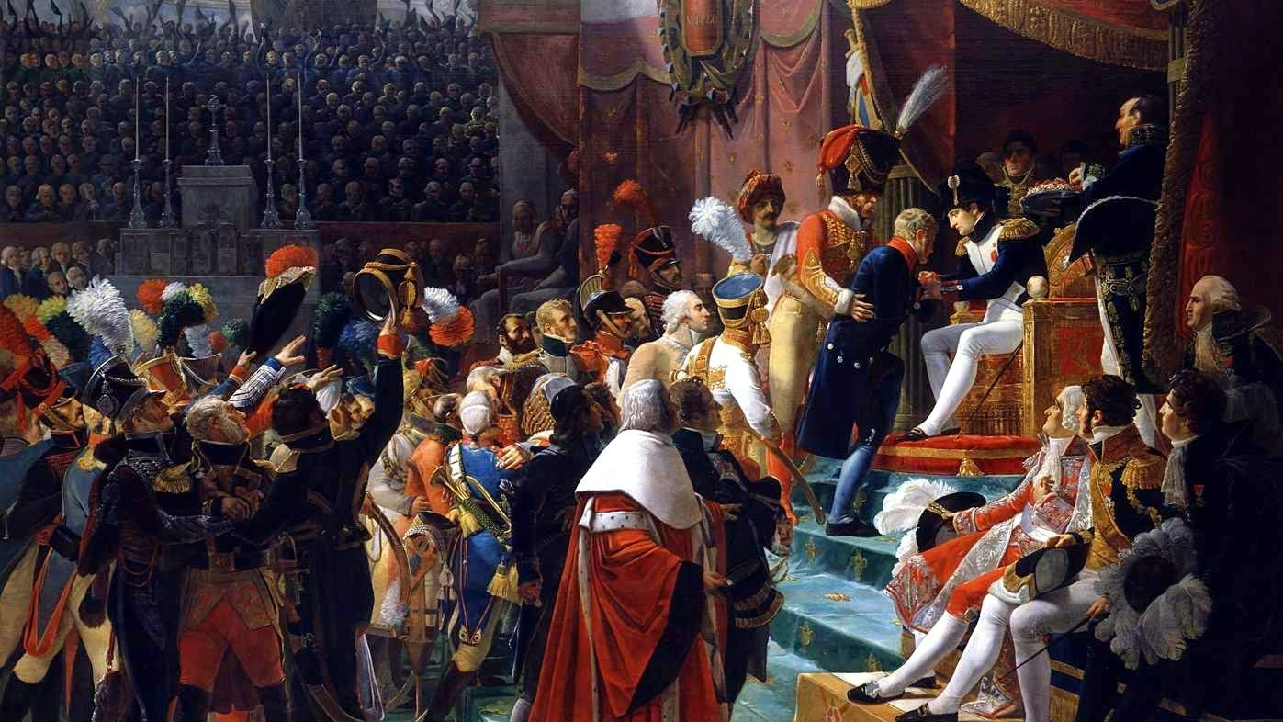
PAST
Notes:
Individual components scalable
Easy to introduce and replace new technology
Easy to deploy new features
Autonomous teams can continue to improve

Slide 8
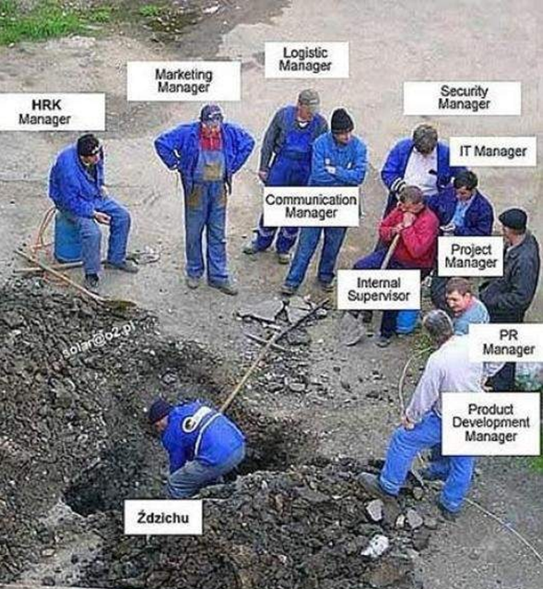

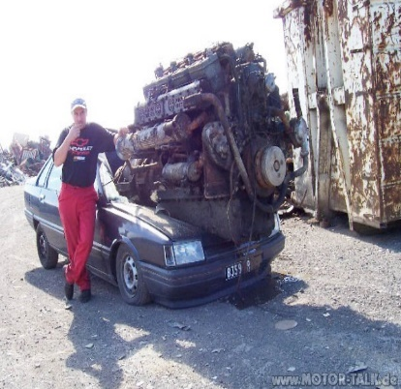
TRADITIONAL ERA
PAST
ORGANIZATION
ARCHITECTURE
DELIVERY
The whole organization was involved in a release (incl. CTO)
Monolithic Application
Releasing to production <5 times a year
Takes months from code commit to move to production
Deployment of the platform to one environment took weeks
High Defect ratio and P1 incidents
Notes:
Individual components scalable
Easy to introduce and replace new technology
Easy to deploy new features
Autonomous teams can continue to improve

Slide 9

NOW
Notes:
Individual components scalable
Easy to introduce and replace new technology
Easy to deploy new features
Autonomous teams can continue to improve

Slide 10
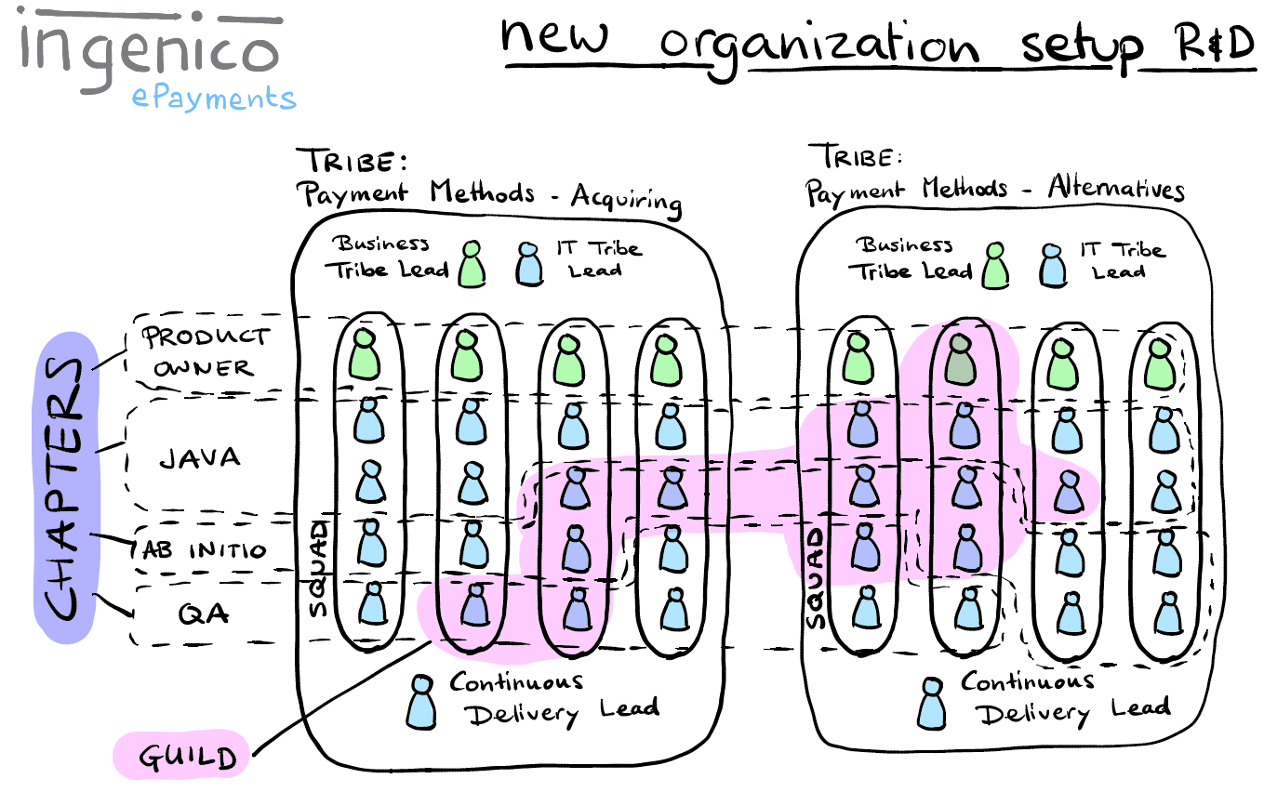
ORGANIZATION.
NOW
Orientation shift from technology to product
More autonomy to the teams while safeguarding market regulations
Inspired by:
Notes:
Individual components scalable
Easy to introduce and replace new technology
Easy to deploy new features
Autonomous teams can continue to improve

Slide 11
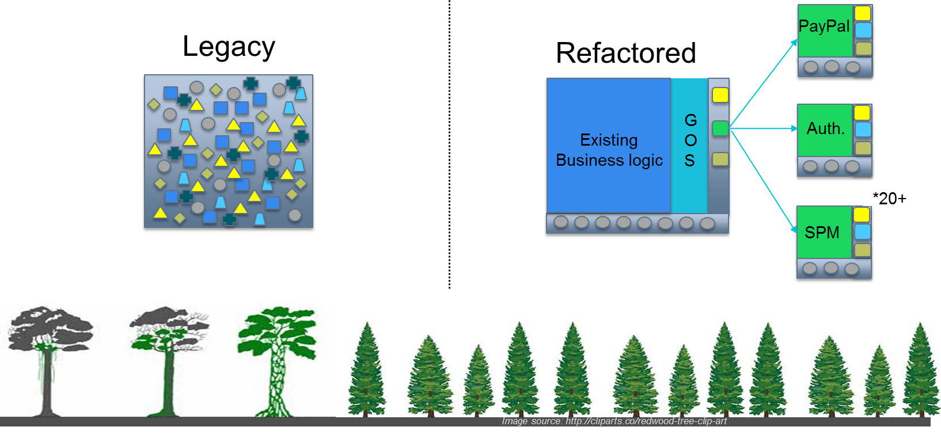

Architecture.
NOW
Inspired by:
Notes:
Individual components scalable
Easy to introduce and replace new technology
Easy to deploy new features
Autonomous teams can continue to improve

Slide 12
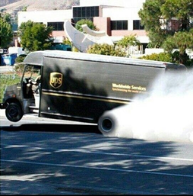
DELIVERY.
NOW
Decoupled releases and deployment
Setup fully automated Continuous Integration and Delivery Environment in the cloud (30.000+ automatic test cases)
Releasing to production at least every week (last month 18+ deployments to production)
On average a release takes around a week from code commit to production
Significant lower defect count in releases and target of 99.999% uptime has been met.
Deployment to one environment of the platform takes less then an hour
Development environment is up and running within a 1-2 day
Inspired by:
Notes:
Individual components scalable
Easy to introduce and replace new technology
Easy to deploy new features
Autonomous teams can continue to improve

Slide 13
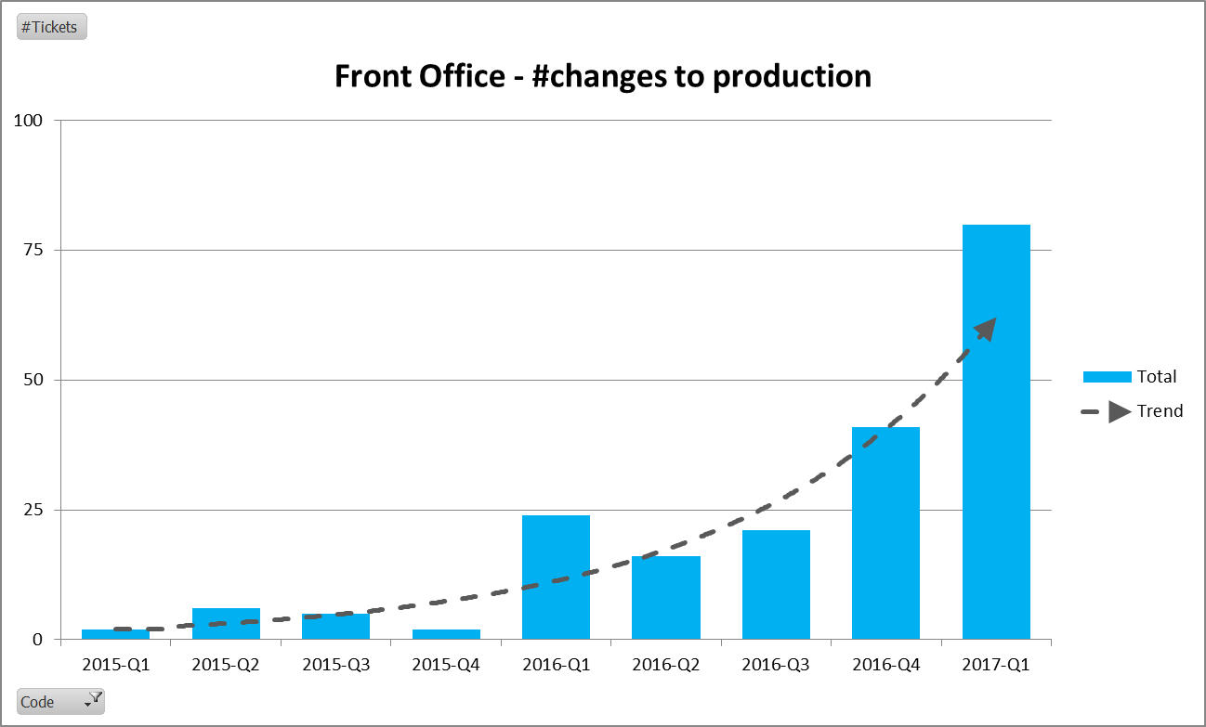
RESULTS
NOW
Multiple releases per month / week
Quickly addressing technical debt
Creating new bottlenecks….
Notes:
Individual components scalable
Easy to introduce and replace new technology
Easy to deploy new features
Autonomous teams can continue to improve

Slide 14

FUTURE
Notes:
Individual components scalable
Easy to introduce and replace new technology
Easy to deploy new features
Autonomous teams can continue to improve

Slide 15


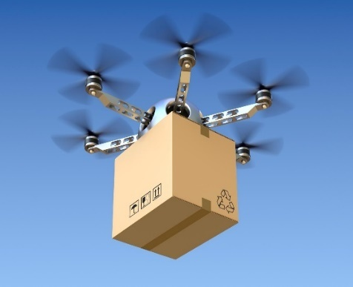


GLOBAL / AUTONOMY
FUTURE
ORGANIZATION
ARCHITECTURE
DELIVERY
Product based
Notes:
Individual components scalable
Easy to introduce and replace new technology
Easy to deploy new features
Autonomous teams can continue to improve

Slide 16

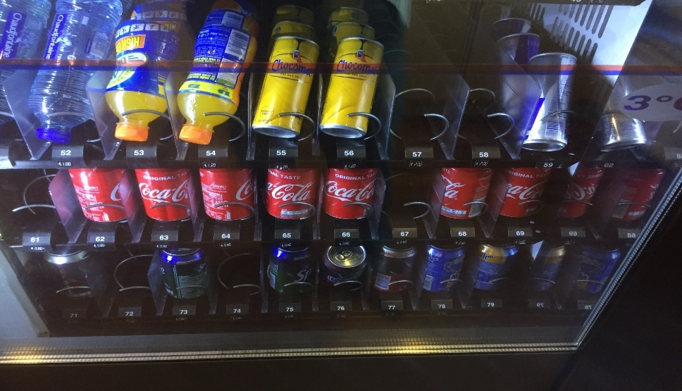
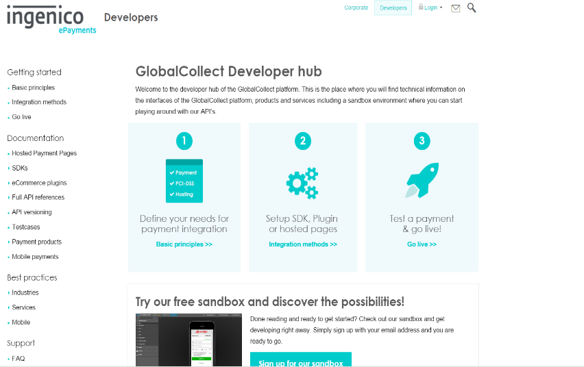

Questions?

Slide 17

Don’t be afraid to change!

